Slide 1


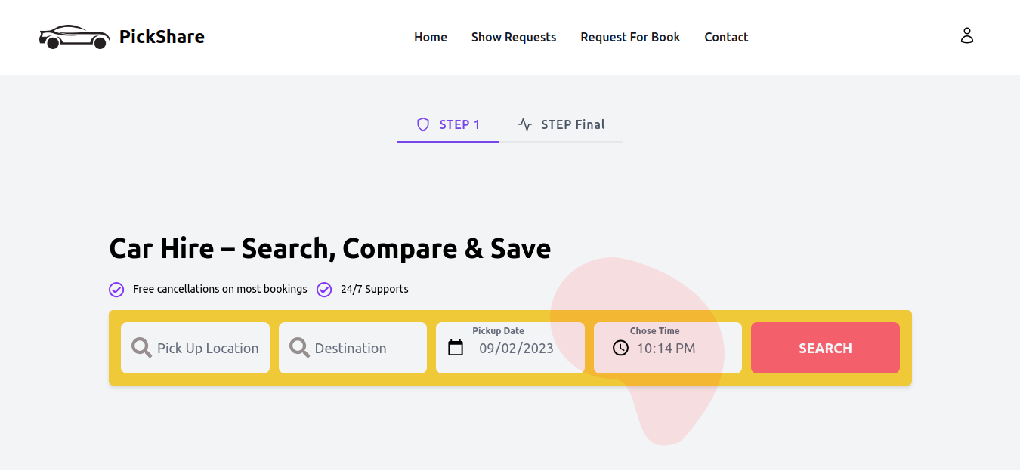

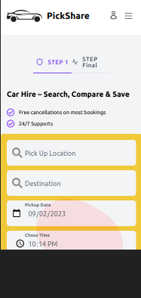
PICK & SHARE
CAR & RIDE SHARING SYSTEM
Project of NCB
National University
Bangladesh

Slide 2
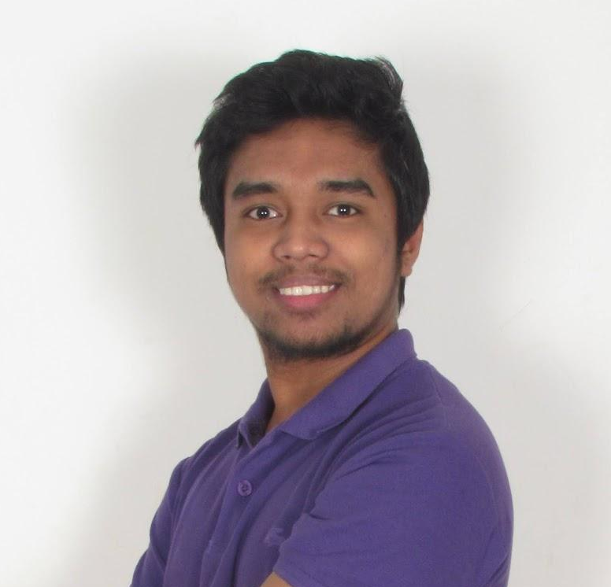

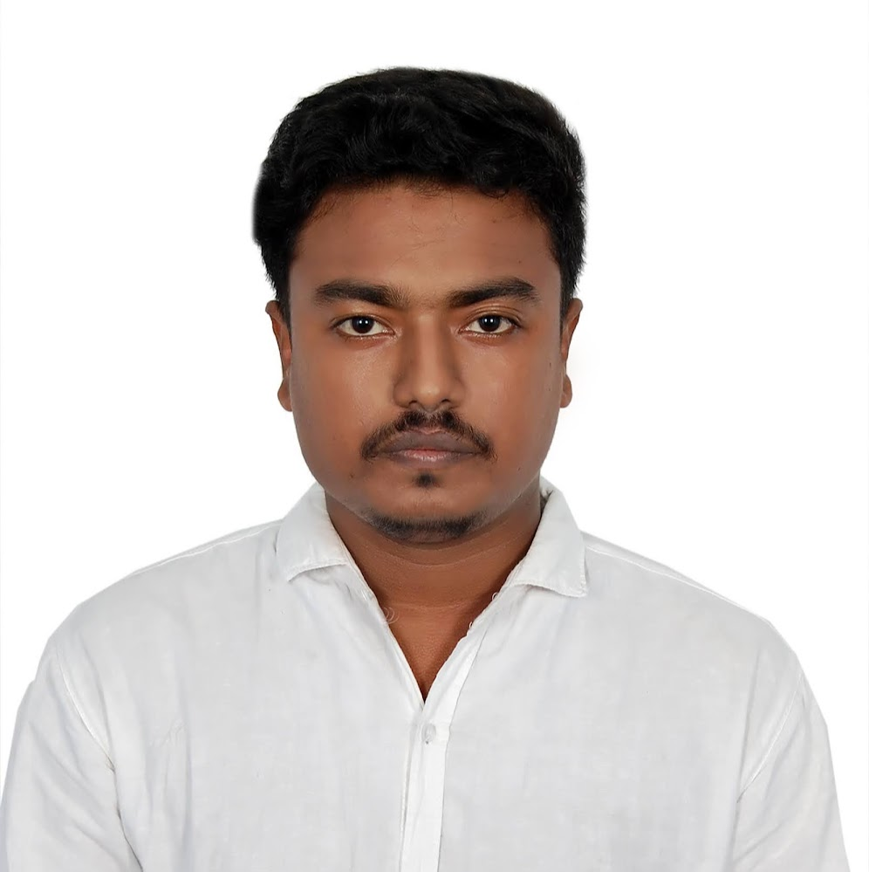
MEET OUR TEAM
AL MAMUN
TEAM LEADER
Tasmina Yasmin
TEAM MEMBER
MD RAFIUL ISLAM
TEAM MEMBER

Slide 3

WHAT IS THIS?
1
Local Car Ride sharing
2
Select any address and details while booking
3
Freedom to choose the Ride
4
Service in whole country
5
Authorized Driver
6
Registered users only can book

Slide 4
MARKET SIZE
$1 Billion
6 million*
45 million*
Market Size
Rides
Users
Analysts at a seminar in Dhaka today
Each month Via ridesharing
All over the country

Slide 5


It’s Online Based Web Applications
Multiple Ride Request can registered users
Any user can request for ride in any time
Dashboard for show requested ride and manage.
FREEDOM
to the
Use
Schedule based Ride requests
After contract user can show driver details & contact with Driver.
Notes:
Need to rethink

Slide 6




Target Audience
Whole Bangladesh People
25% normal user used ride sharing, also long distance solution is this application..
Driver - Local Driver / Agencies
Local car agency can apply to be driver and after verify the driver can bid/apply to booking request

Slide 7
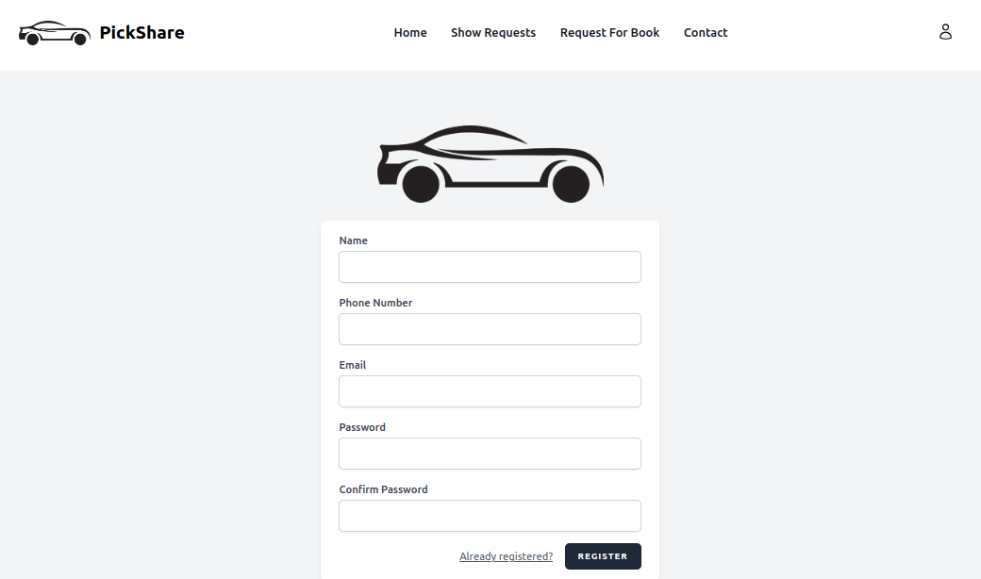
EASY REGISTRATION PROCESS
Profile picture will come from Gravatar API, no need to upload this.
This registration system for all user/drivers

Slide 8
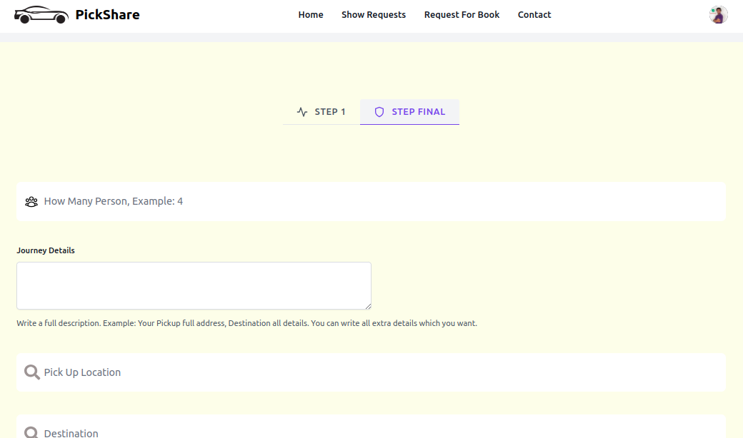
EASY BOOKING PROCESS WITH SCHEDULE

Slide 9
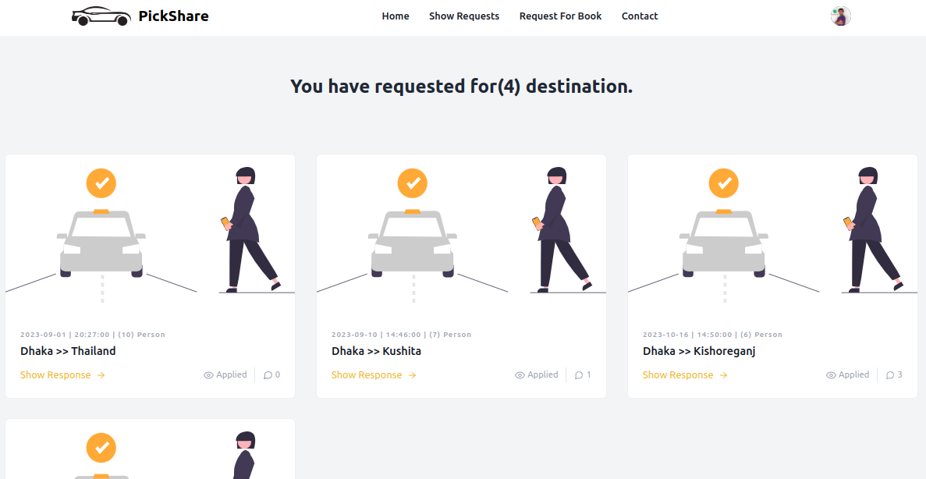
MANAGE ALL BOOKS

Slide 10
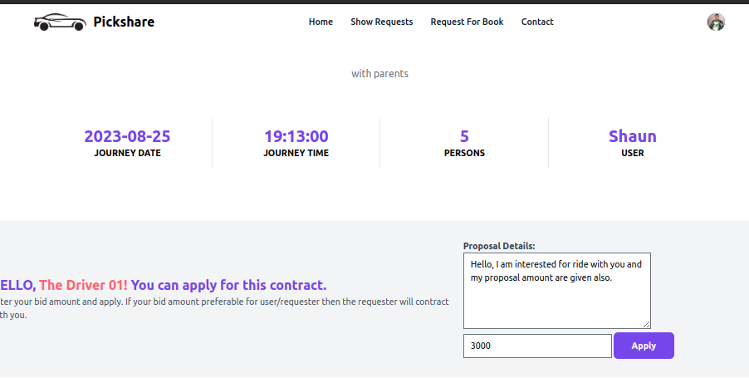
DRIVER APPLY

Slide 11
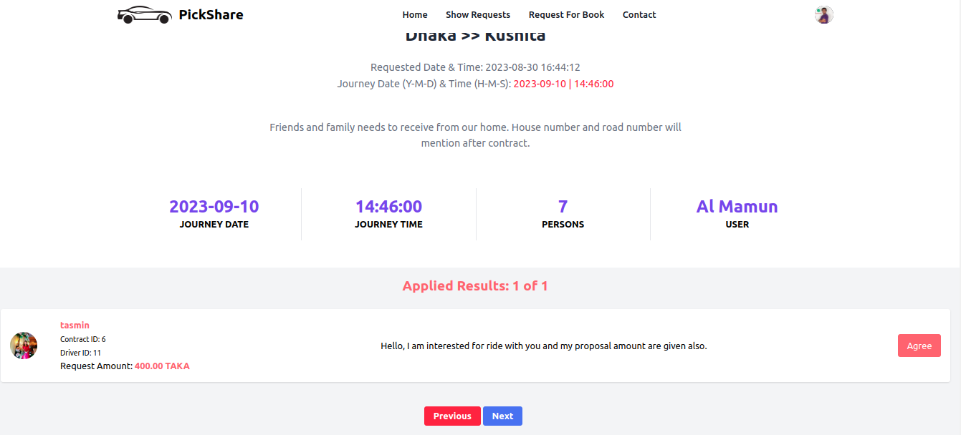
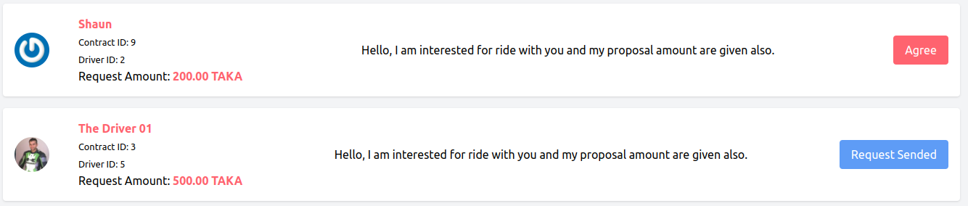
CHOSE DRIVER

Slide 12
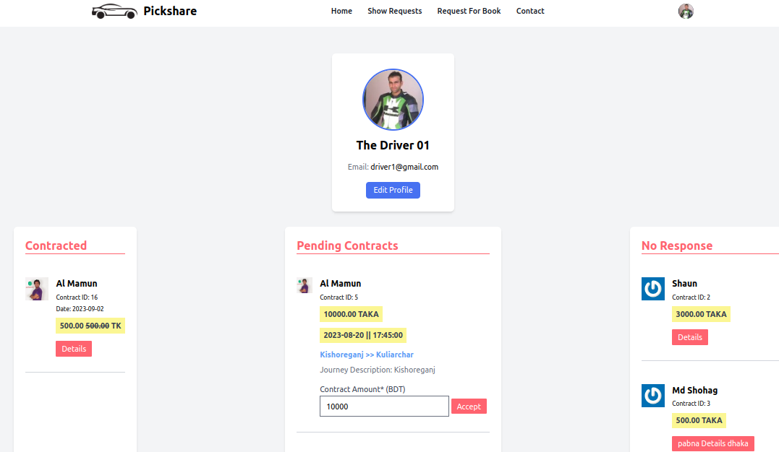
DRIVER DASHBOARD

Slide 13
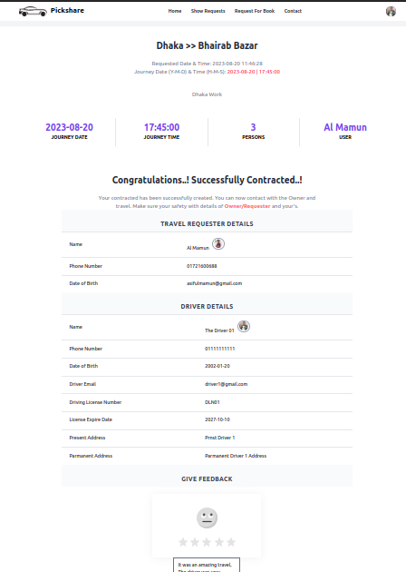
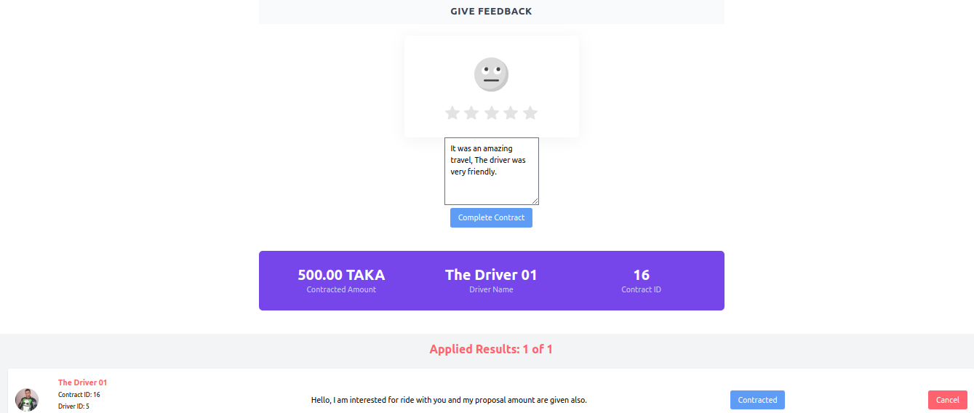
CONTRACTED DETAILS
DRIVER/ USER

Slide 14
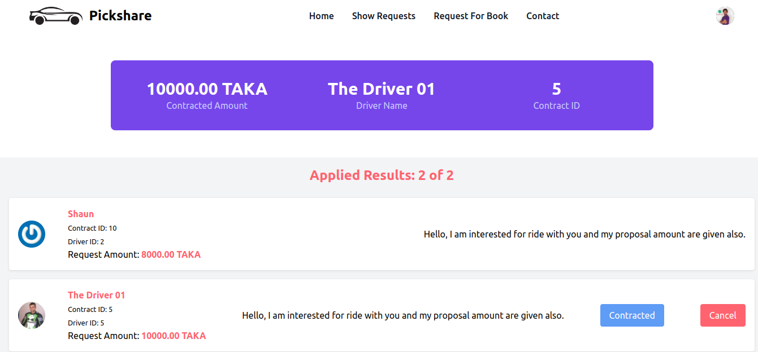
USER/DRIVER NOT UPDATEABLE WITHOUT CANCEL BY ADMIN OR WHILE CONTRACTED

Slide 15
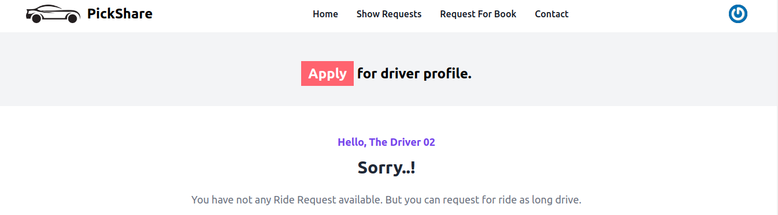
DRIVER PROFILE

Slide 16
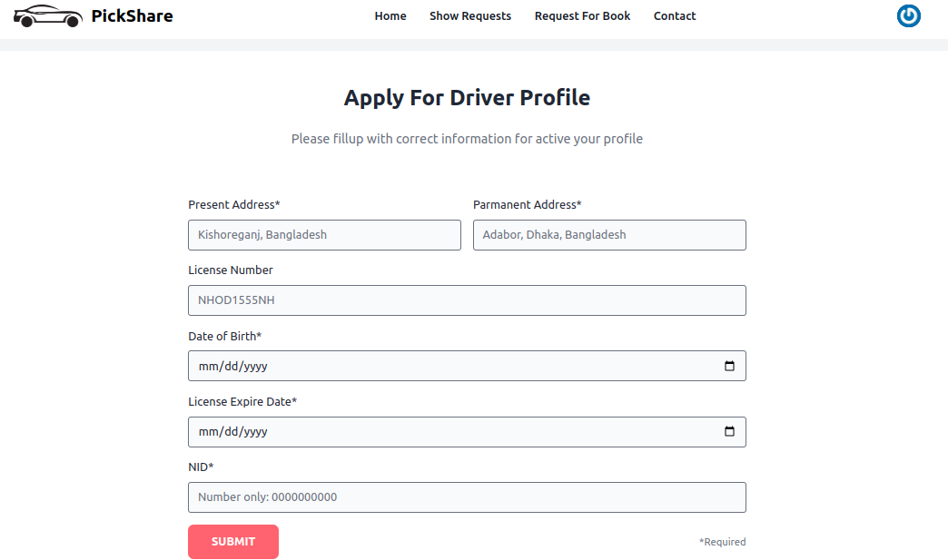
DRIVER PROFILE

Slide 17
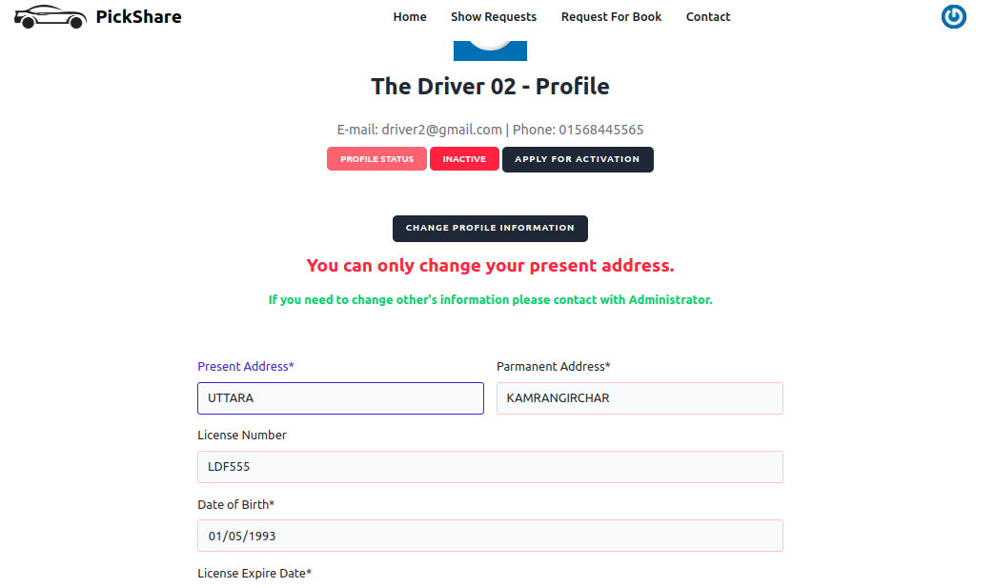
DRIVER PROFILE MANAGE

Slide 18
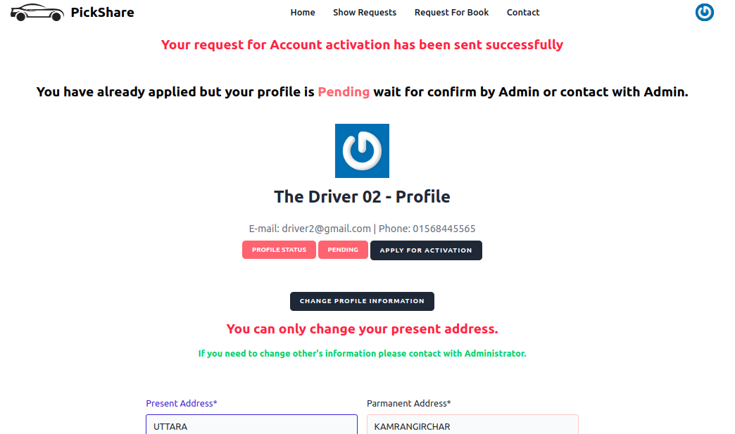
DRIVER PROFILE STATUS PENDING

Slide 19
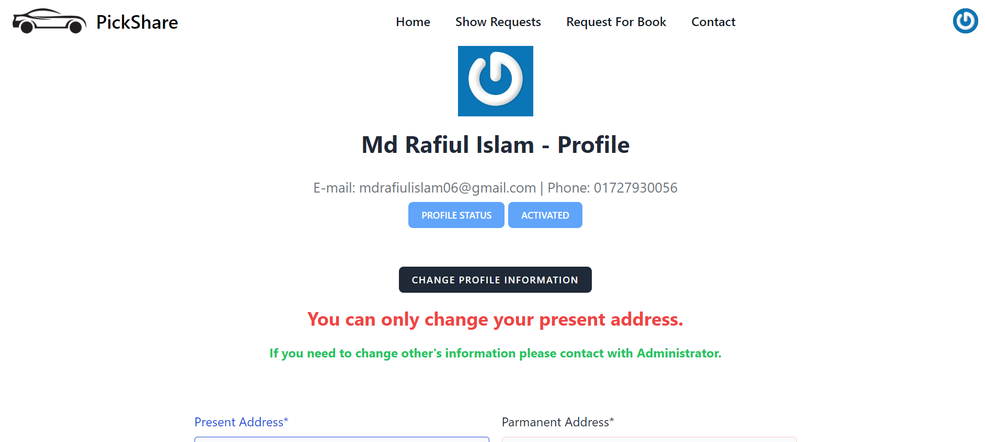
DRIVER PROFILE STATUS ACTIVATED

Slide 20


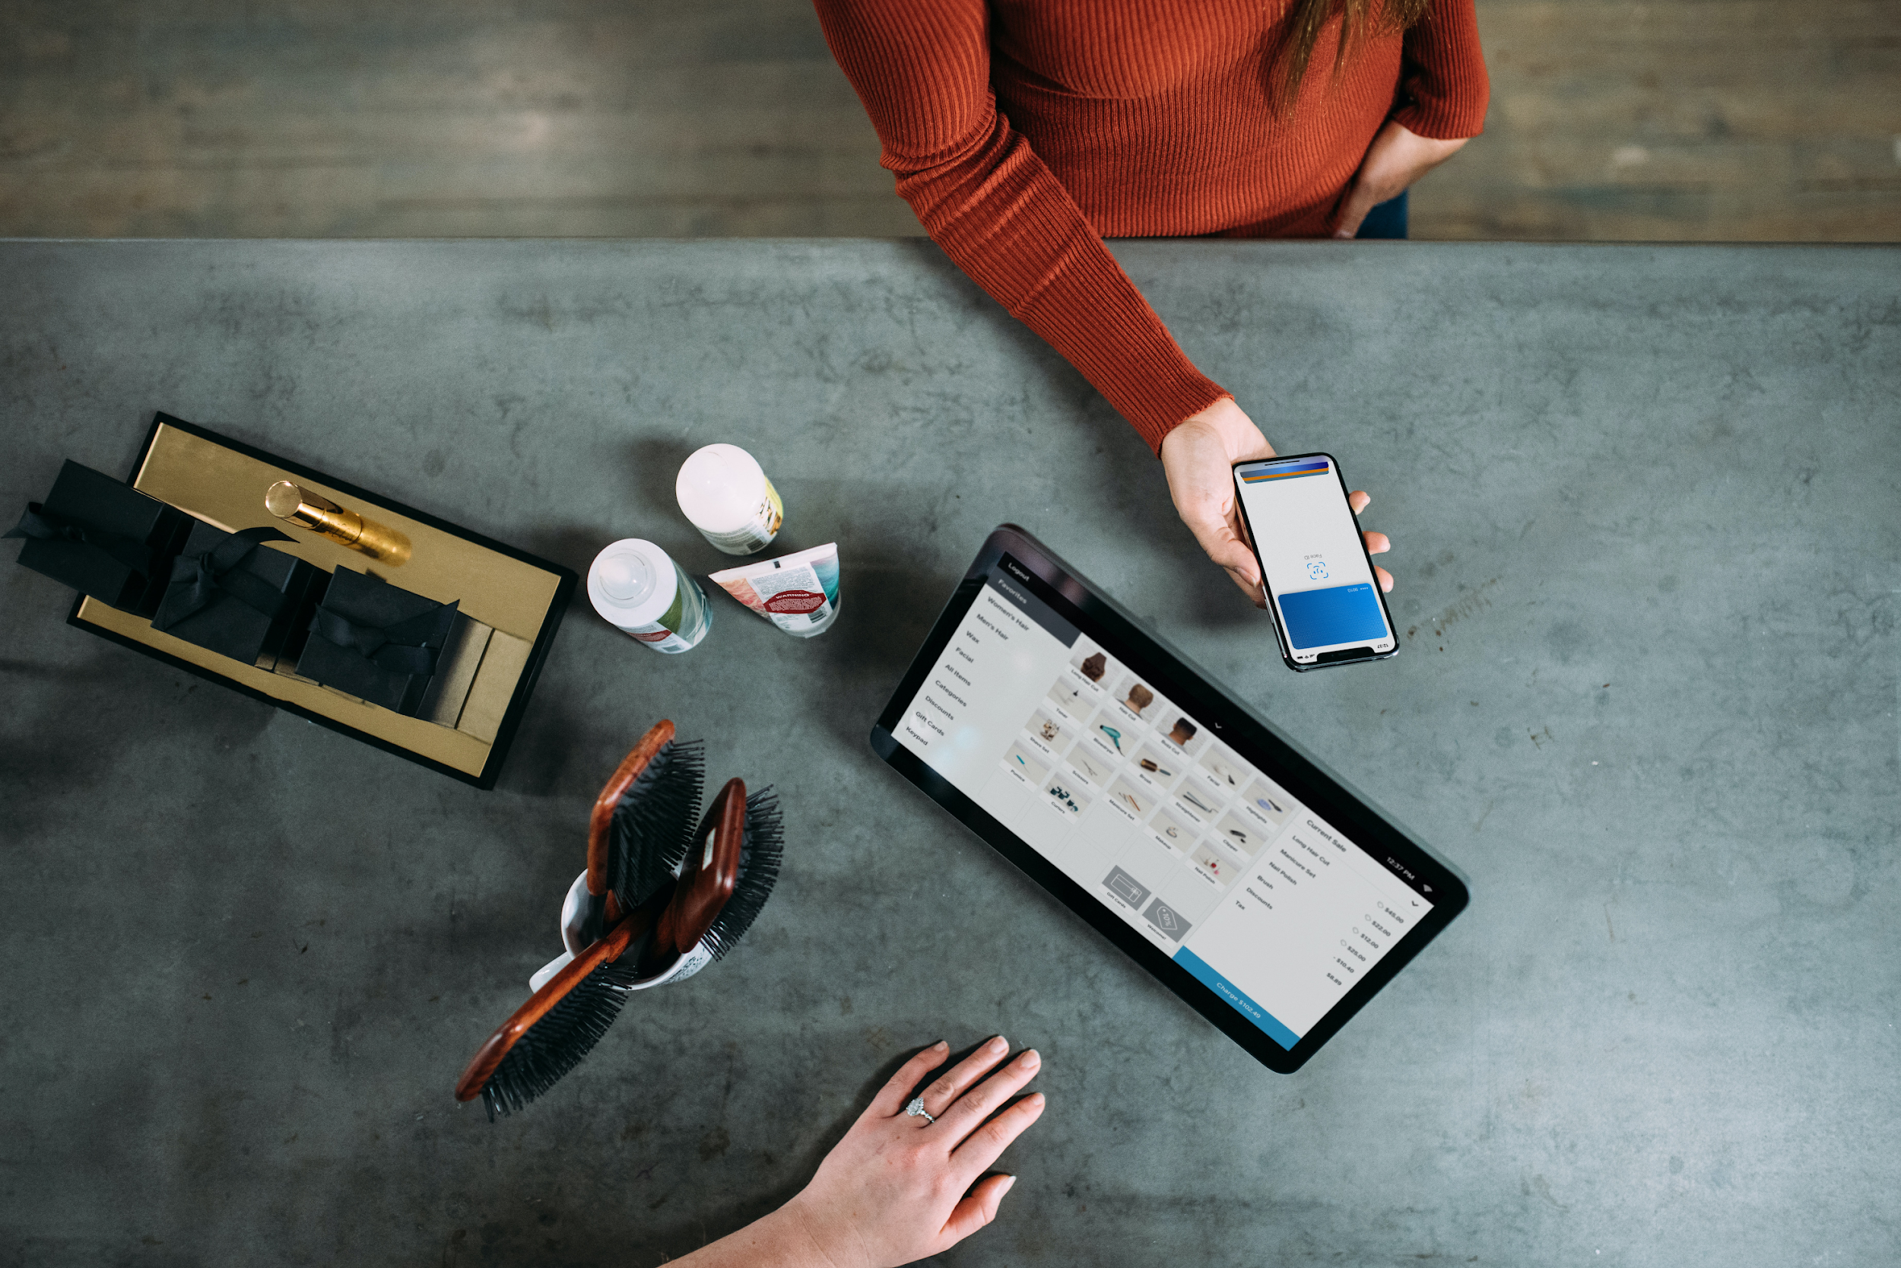
>
Control Driver
User can see all in-active driver and can be activated.
ADMIN CONTROL
Price is too high
Per order processing fee
Few have android/iOS app
Developed by scratch and miss the thousand useful plugin integration opportunity
Accept and pending driver make as active driver
>
Pending Drivers Activation

Slide 21
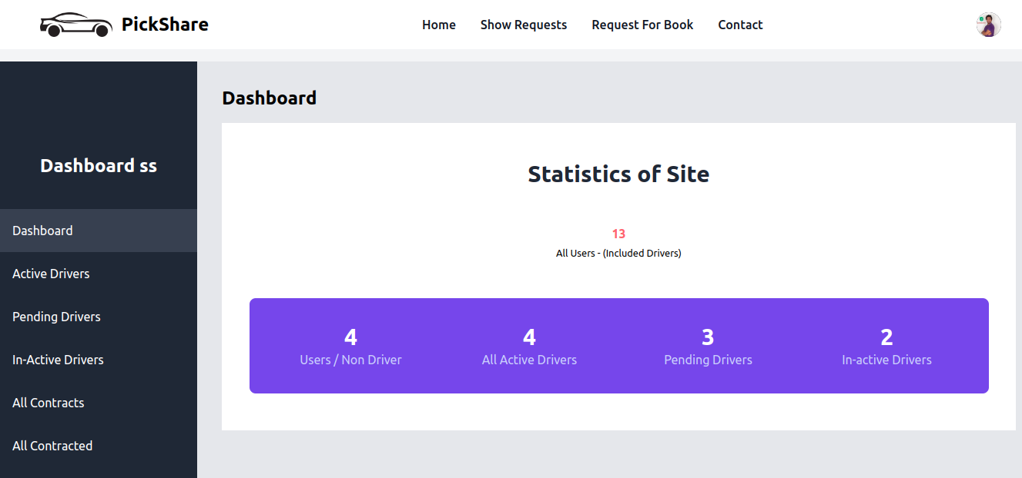
ADMIN CONTROL

Slide 22
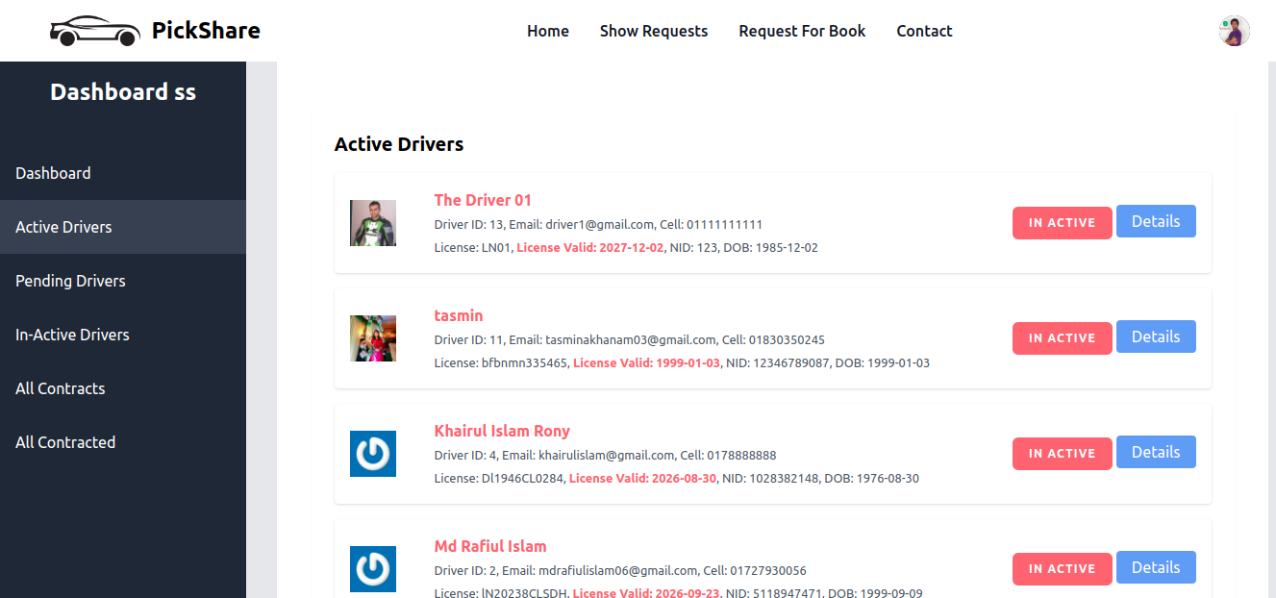
DASHBOARD CONTROL

Slide 23
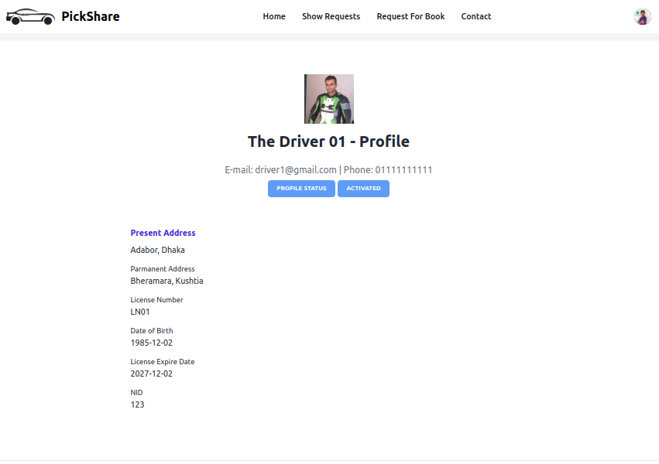
DRIVER
PROFILE
Admin can see driver profile individually and verify the driver as per require.

Slide 24
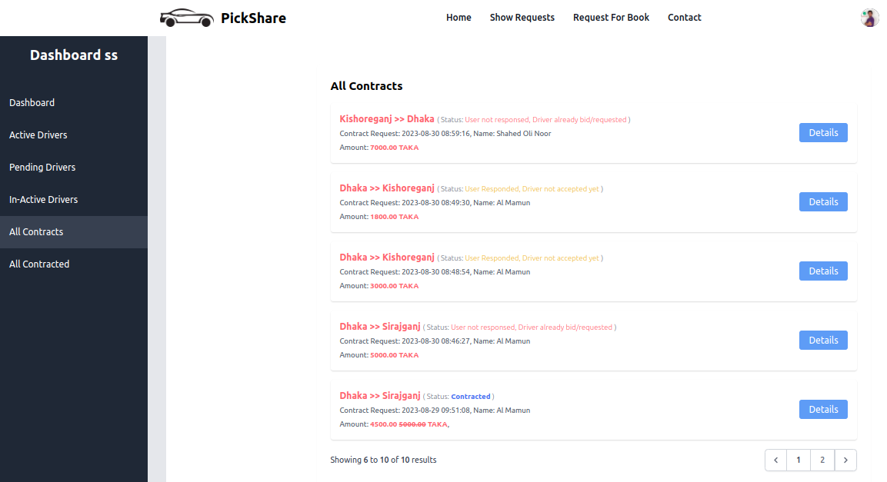
ALL CONTRACTS
Admin can see all of contracts details with status.

Slide 25
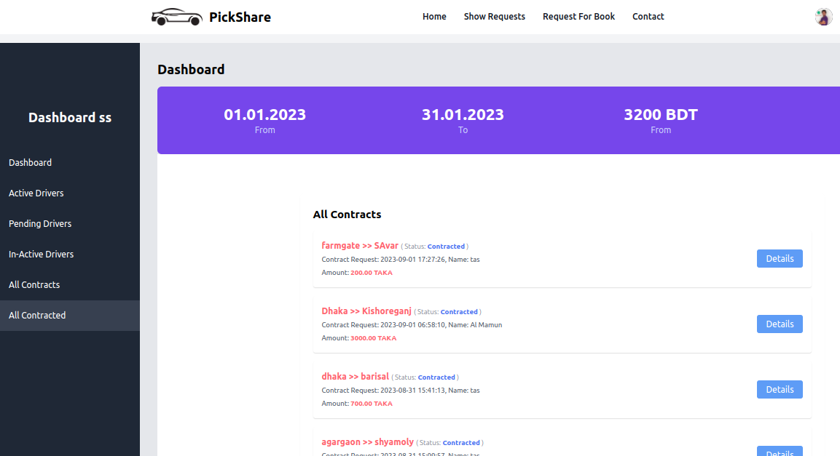
SEE ALL CONTRACTED AMOUNT LAST MONTS
Customized or filtered date will coming soon

Slide 26

UPCOMING FEATURES
Text messaging / calling communication - Driver>>User
Admin filtered view, and all of visual history as Chart etc.
Opensteet MAP api for GEO Location based PICKUP & DESTINATION.

Slide 27
UPCOMING FEATURES
Android application, and provide API to 3rd party users or developer.
Dispute system / User or Driver can also cancel requests
Notification System / SMS/ E-mail / Web Notification

Slide 28
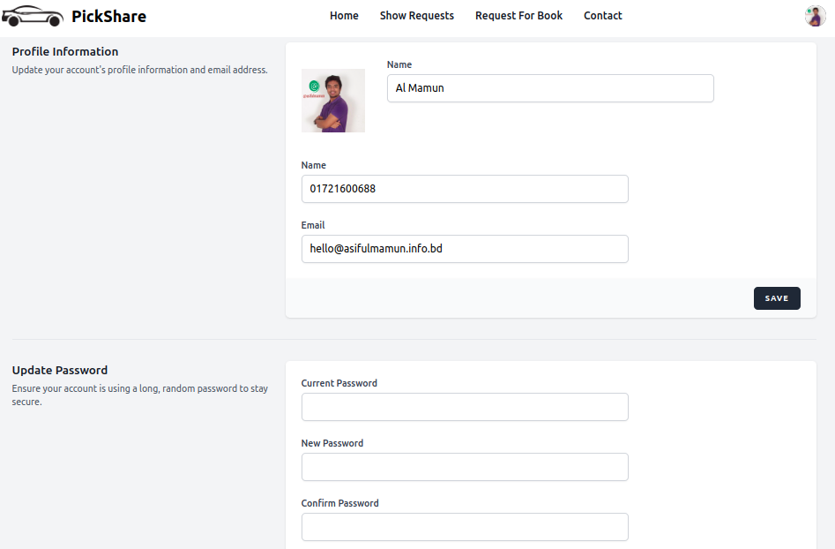
ACCOUNT UPDATE
User can change their profile personal information without Driver.
All users/Driver can Update their password.

Slide 29
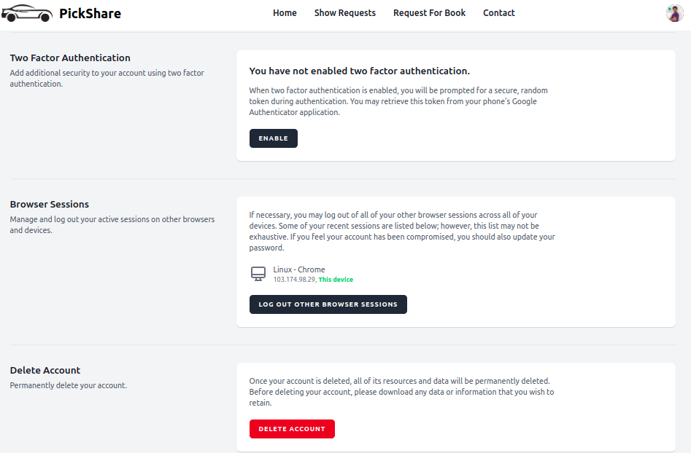
SECURITY
It has 2FA facilities for stronger secured profile.
Browser session manager for manage duplicate or inactive session.
Also has account delete system.

Slide 30
Let’s Talk About Privacy
Driver Privacy
User Privacy

Slide 31
Pricing
FREE..! FREE…! FREE…!

Slide 32

BUT WHY..!

Slide 33

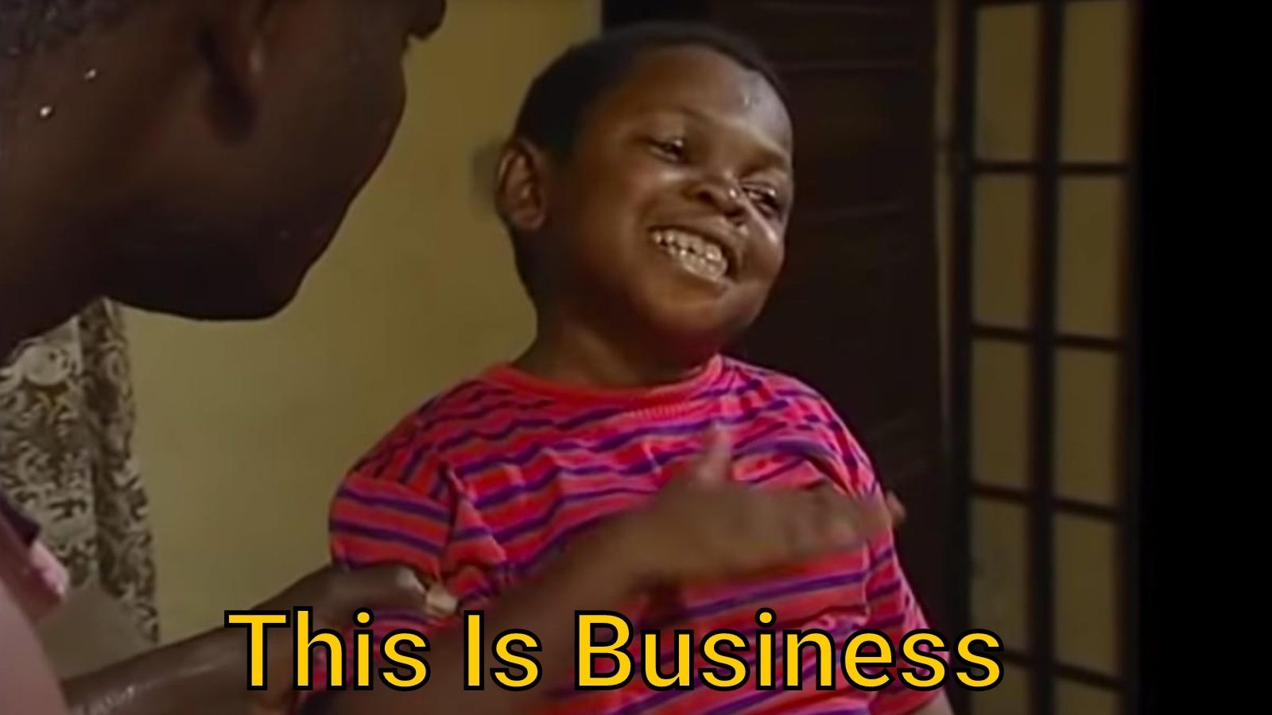
SIMPLE
THIS IS BUSINESS

Slide 34








Let’s Talk About Frontend / Backend

Slide 35

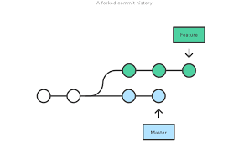











TOOLS / IMPLEMENTATION

Slide 36

ANY QUESTIONS?

Slide 37

THANK YOU

